Slide 1
Weekly Project Update
Laurent Bialylew
Jalal Mammadov

Slide 2
Work done this week
01
02
03
Created UMLs
Added new UML diagrams
Added new templates
Fixed all the template issues
Updated Log vehicle function
Log vehicle function now detects whether or not a logged vehicle is an emergency vehicle, and the system reacts accordingly

Slide 3
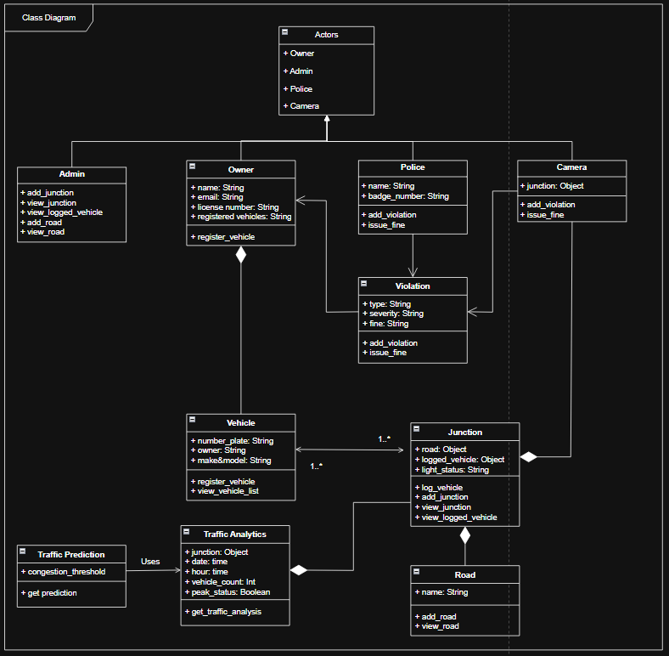
Class Diagram

Slide 4
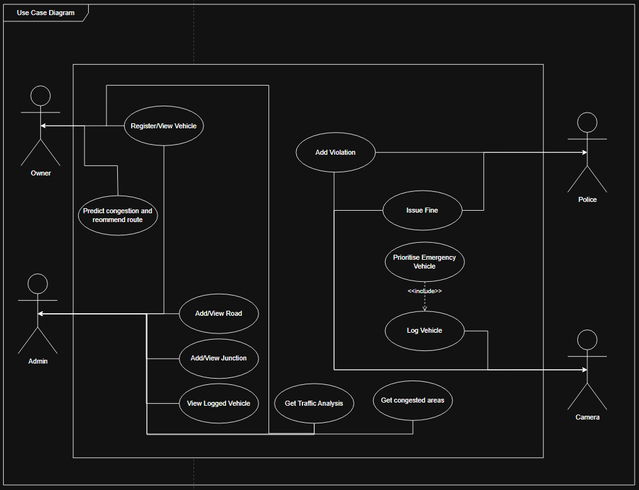
Use Case Diagram

Slide 5
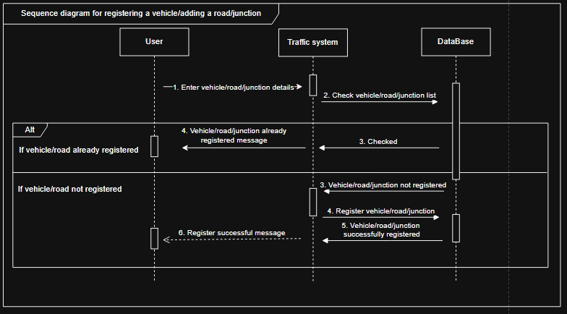
Sequence Diagram registering and adding vehicles/roads/junctions

Slide 6
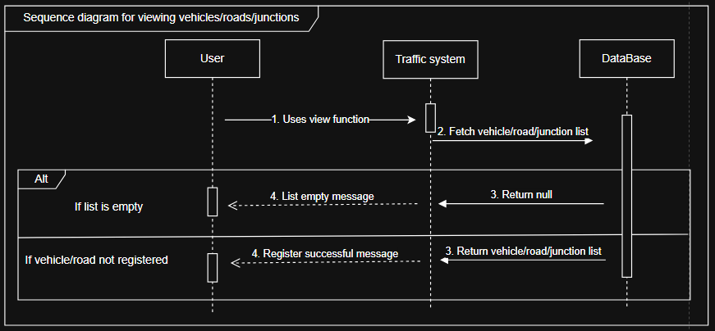
Sequence Diagram for viewing list of vehicle/road/junction

Slide 7
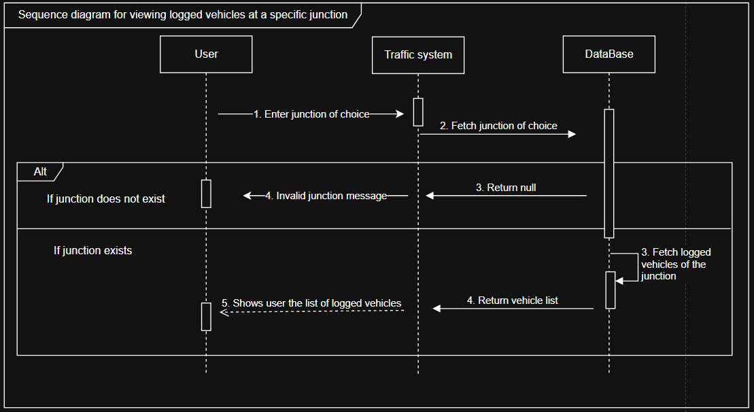
Sequence Diagram for viewing logged vehicles at a specific junctions

Slide 8
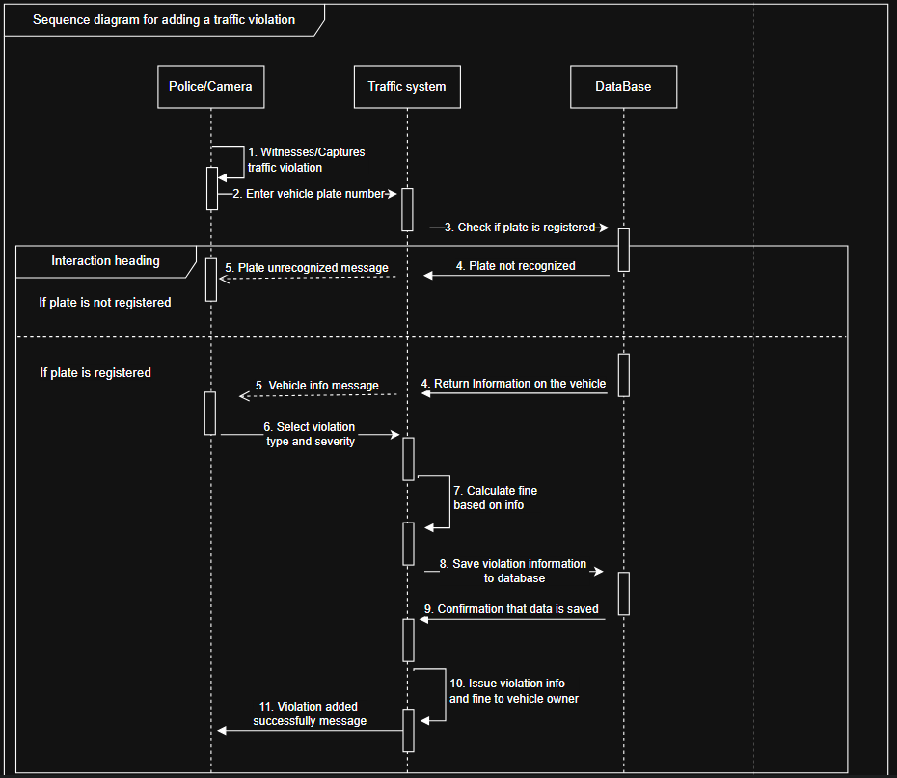
Sequence Diagram for issuing traffic violations and fines

Slide 9
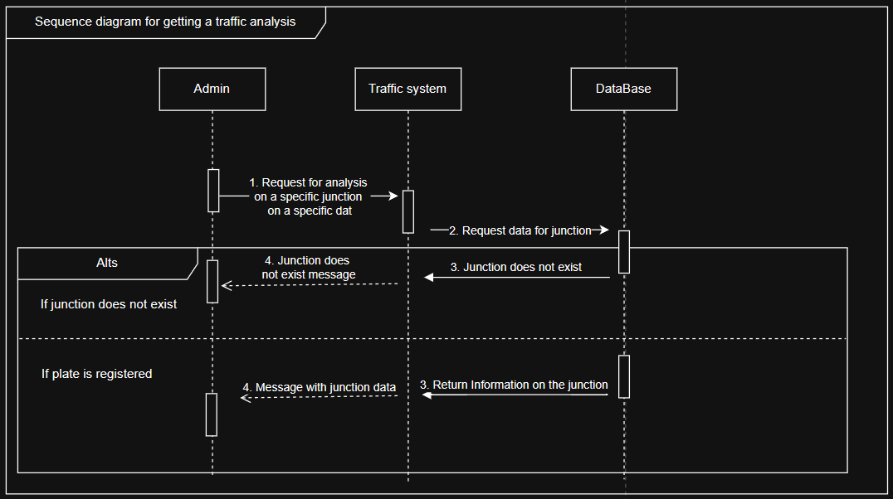
Sequence Diagram for getting a traffic analysis

Slide 10
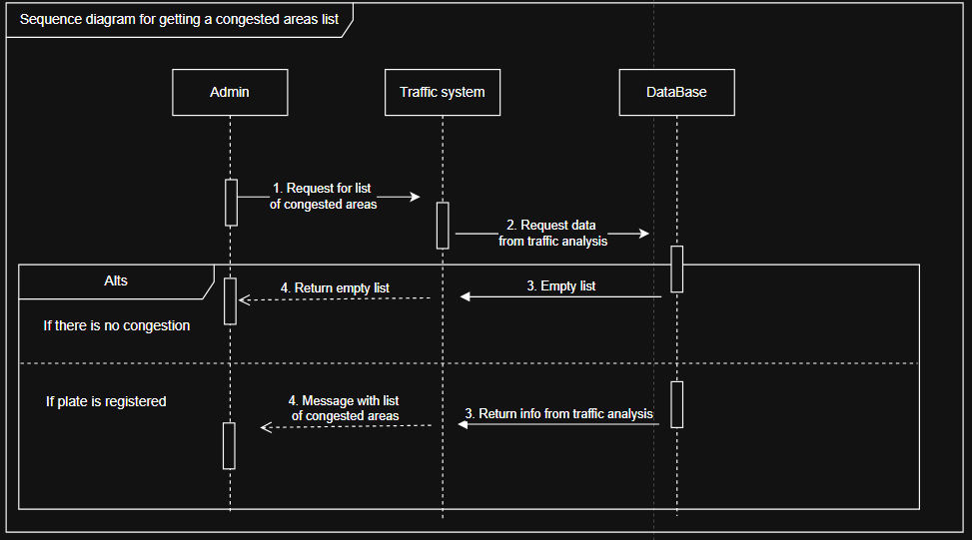
Sequence Diagram for getting congested areas

Slide 11
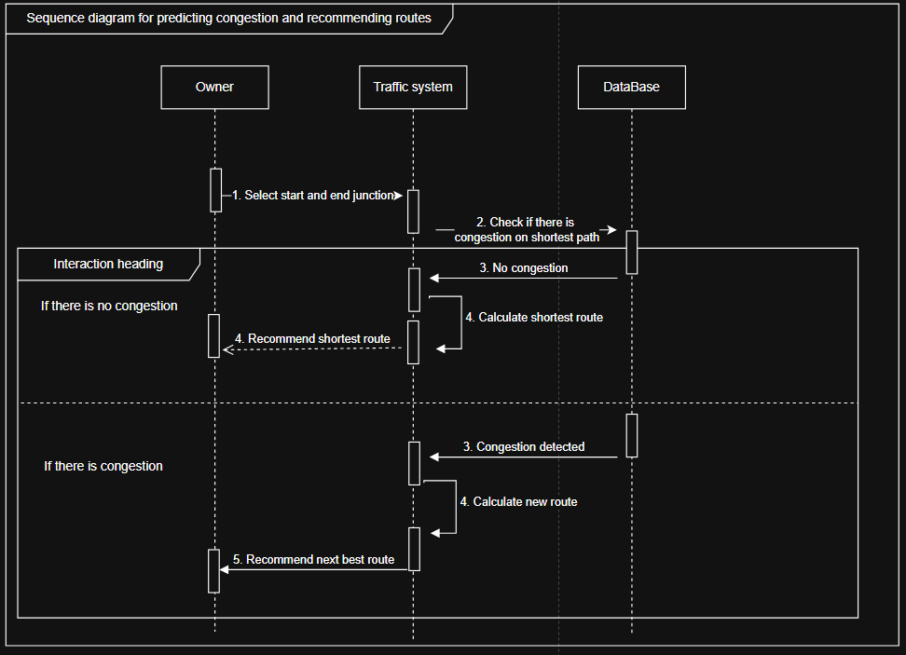
Sequence Diagram for predicting congestions and recommending new routes

Slide 12
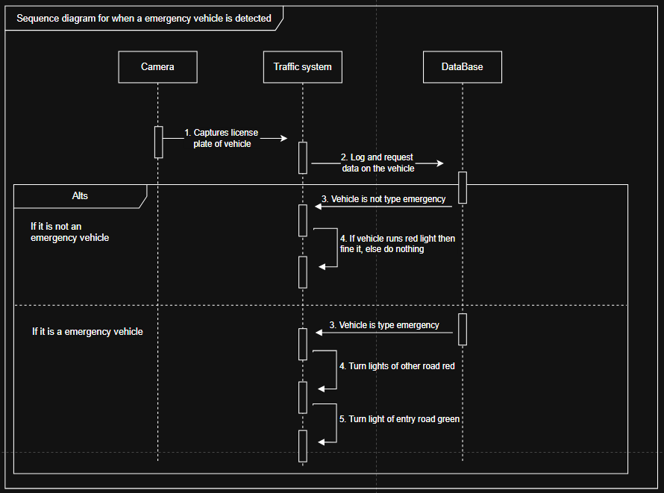
Sequence Diagram for when emergency vehicle is detected

Slide 13
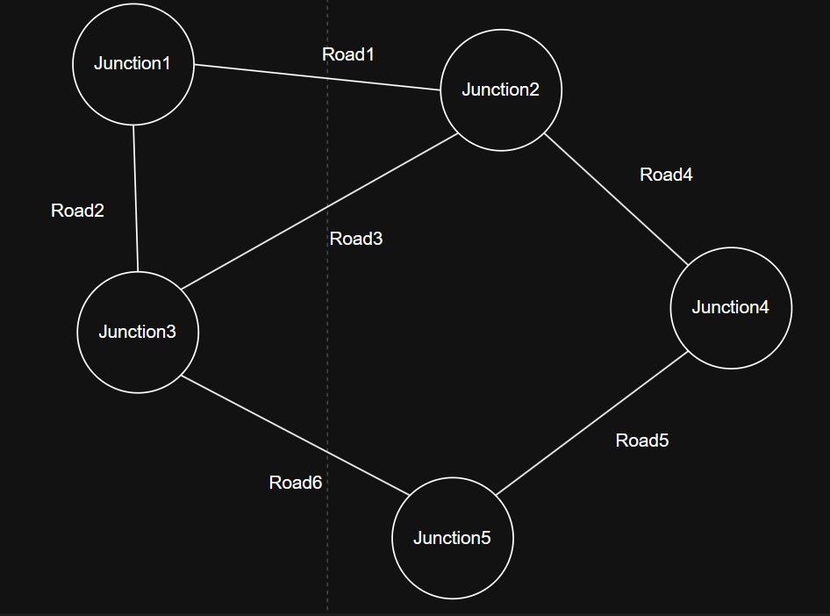
Showcase

